Slide 1
Stepwise Instructions >> How to Download Classnotes , DPP , Exercise Sheet

Slide 2
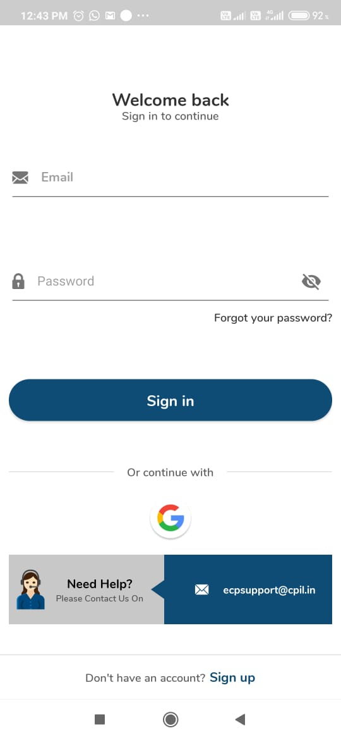
Step 1: Sign in your account with Registered Mail id and Password

Slide 3
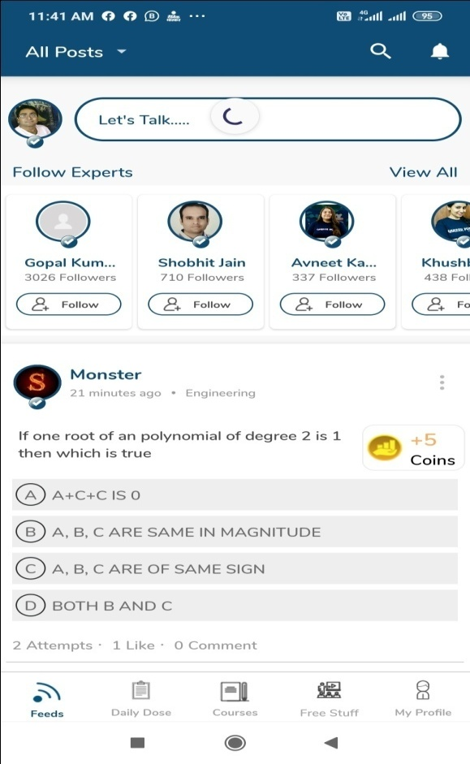
Step 2: Now, Go to my profile section

Slide 4
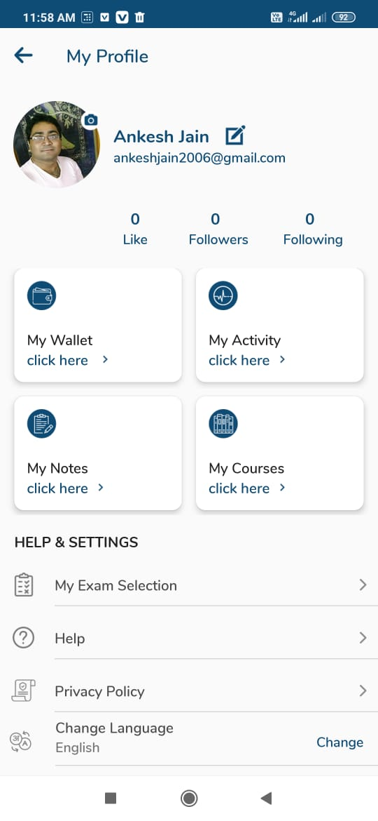
Step 3: Go to My Profile >> My Courses
”
Step 4: Click on your Purchased Course

Slide 5
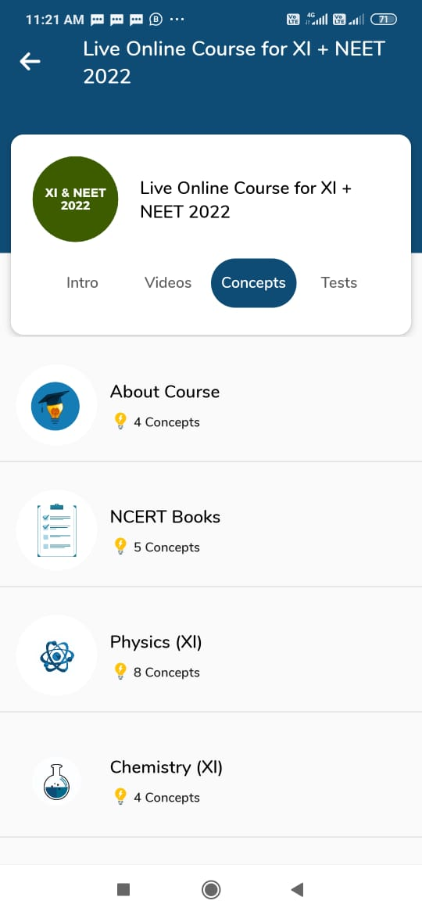
CONCEPTS >>
Step 5: Click on the Concepts to get Class Notes and Daily Practice Problem Sheet (DPPS) >>

Slide 6
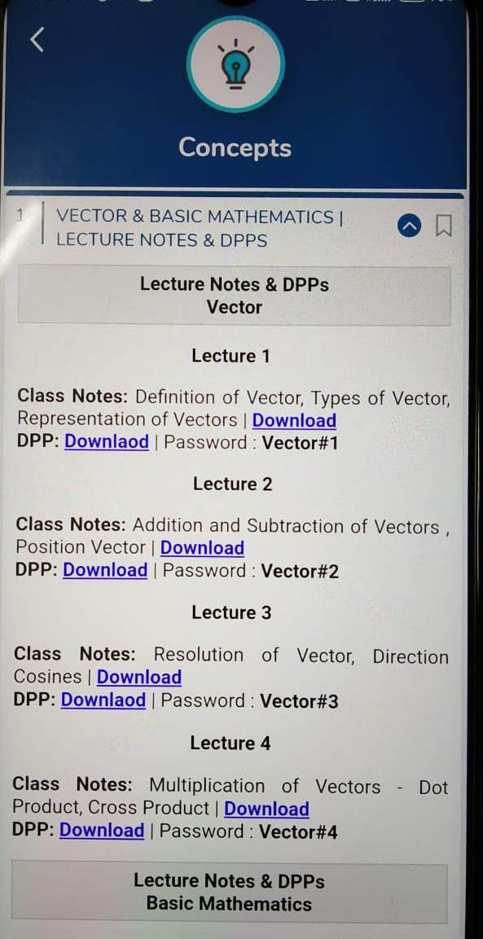
CONCEPTS >>
Step 6: (i) For Class Notes you have DOWNLOAD mentioned over there click on that and PDF gets downloaded
Step 6: (ii) For Exercise Sheet and DPP click on DOWNLOAD after downloading the PDF copy the password of that same PDF mentioned right next to DOWNLOAD option and paste it to open the PDF

Slide 7
For any Technical Support >>
In case of any technical or academic support related to the app or the course students may contact us as:
Call: 0744-6630510 Email: support@cpil.in

